Slide 1

MAKE MY TRIP
Prasanna
Poornima
Priyanka
Sushma

Slide 2


content
About my project
Process of testing and sprint plan
High level epic and user stories
Test scenarios
Requirements
Test cases
Defects
Traceability matrix
Summary report
Challenges faced and how did we overcome

Slide 3
About Make my Trip
Make my trip is an Indian online travel organization established in 2000
Deep Kalra- chairperson and group CEO of make my trip.
Headquartered in Gurugram, Haryana.
It has 65 retail stores across 50 cities in India.
MMT was listed on the NASDAQ(National association of securities dealers automated Quotations): on 17 August 2010

Slide 4
Role of testers in each module
Roles
Member
Login functionality
Reset password
Train functionality
Flights functionality
Hotels functionality
Bus functionality
Airport cabs functionality
Prasanna
Prasanna
Poornima
Poornima
Priyanka
Priyanka
sushma

Slide 5
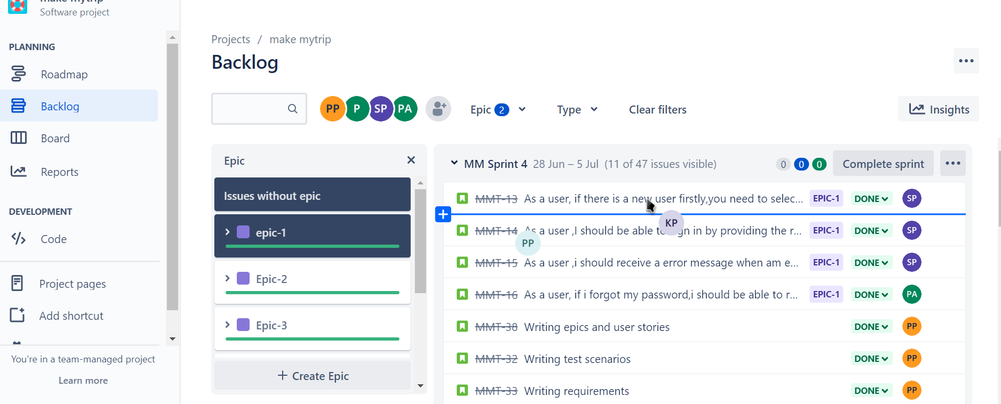
Process of testing and sprint plan

Slide 6
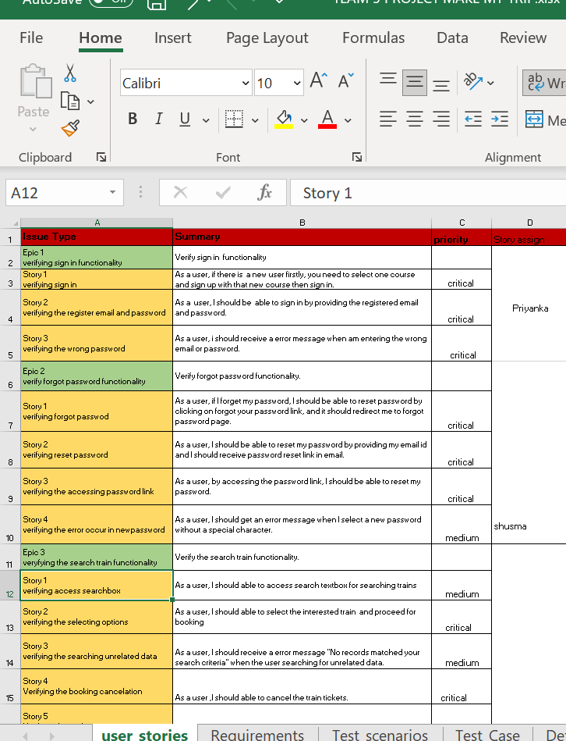
High level Epic and user stories

Slide 7
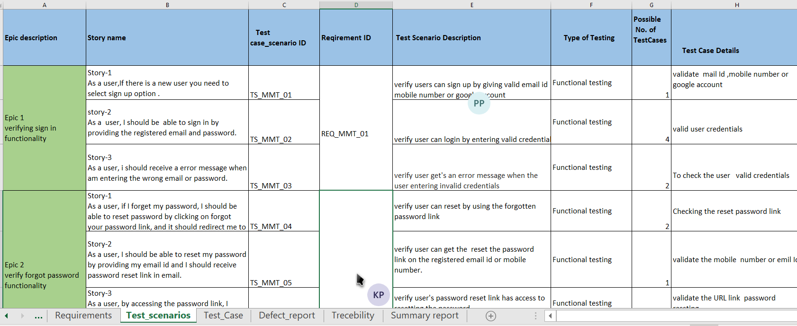
Test scenarios

Slide 8
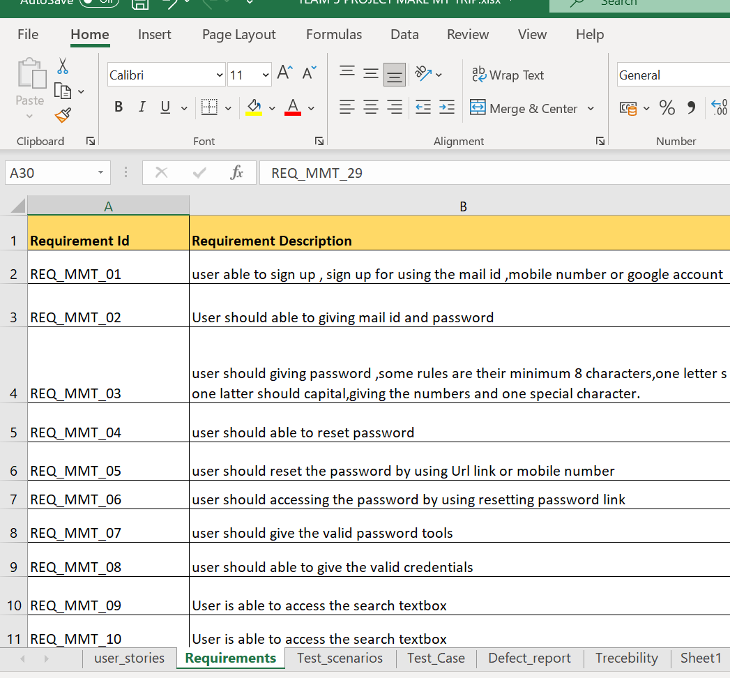
Requirements

Slide 9
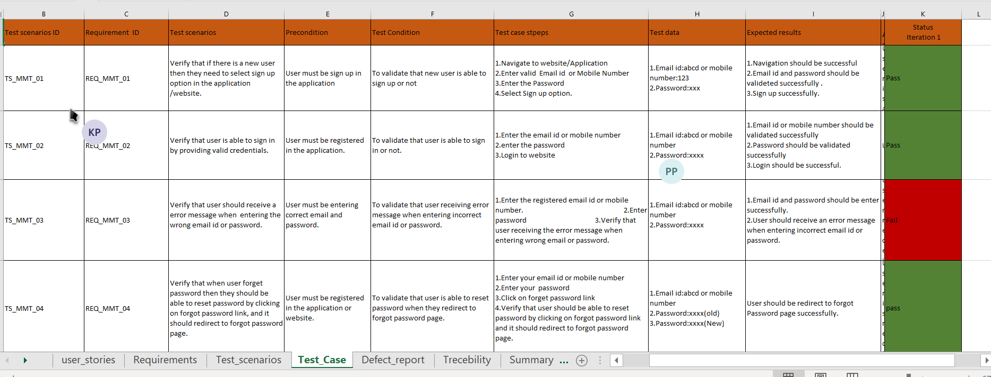
Test cases

Slide 10
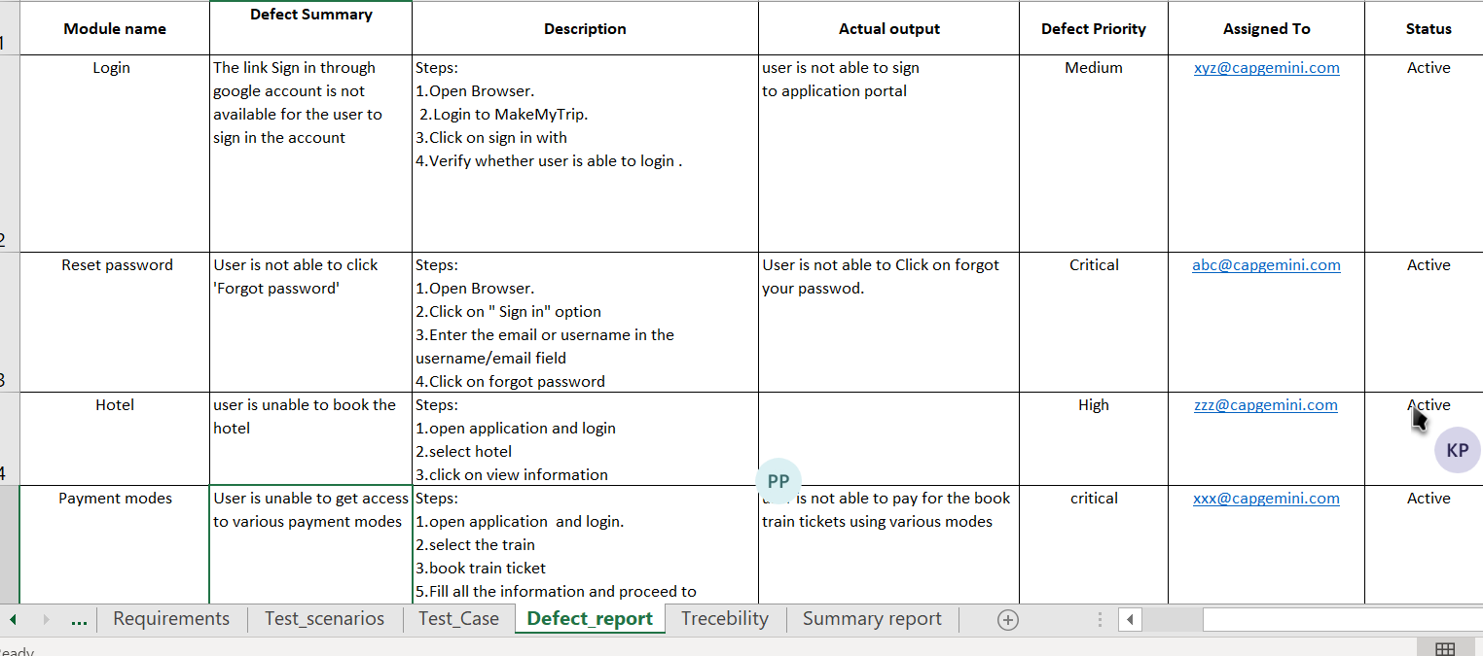
Defects

Slide 11
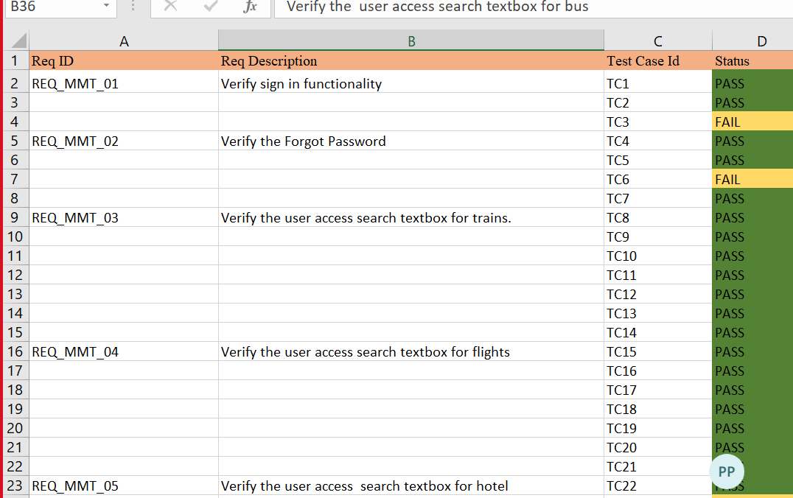
Traceability Matrix

Slide 12
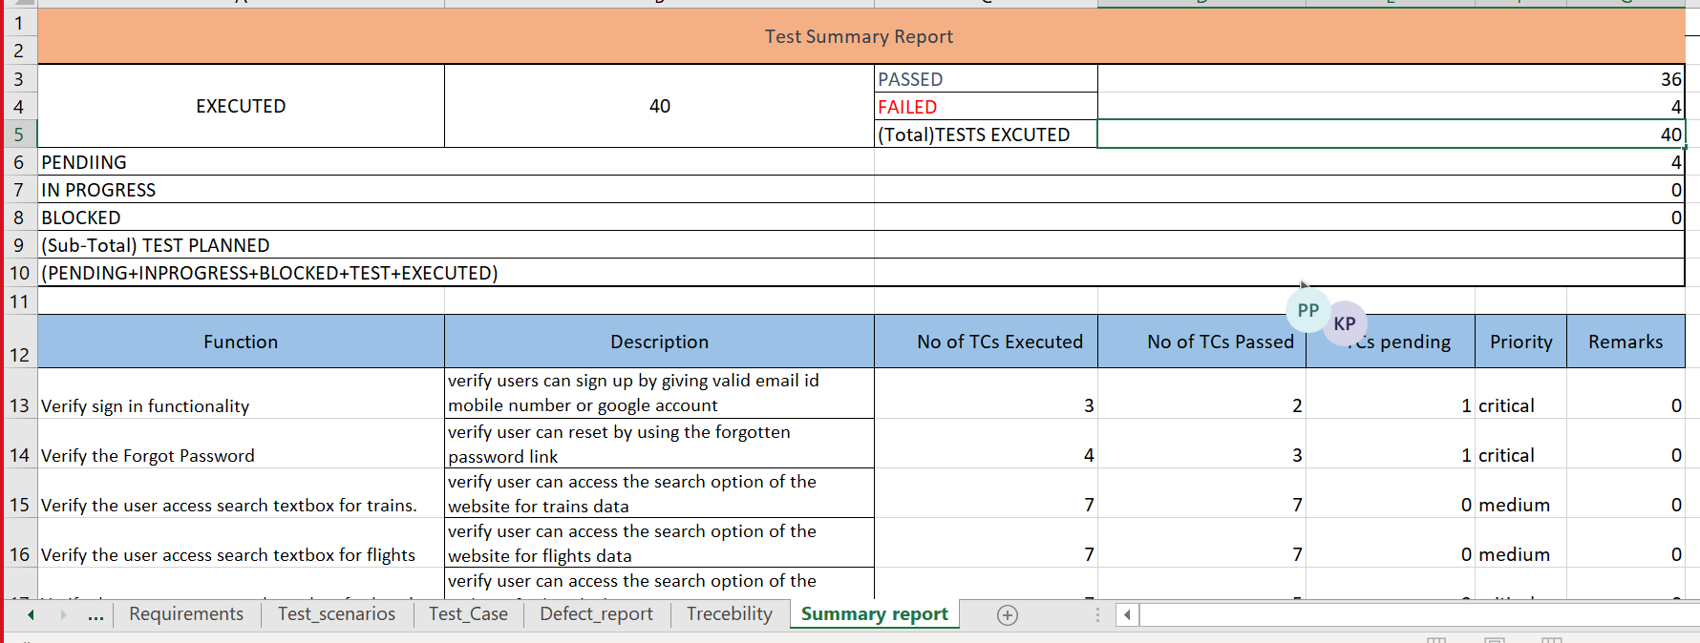
Summary Report

Slide 13
Challenges faced and how did we overcome
In our project we are scared about how to do work in Jira .In that time our trainer will Explain each and everything about Jira
One of the issue we faced is to identifying the bugs in our project.

Slide 14





Thank you

